Slide 1



8TH SEMESTER PROJECT PHASE -02
SUBJECT CODE:18ECP83
PROJECT ON
OPTIMIZING TRANSPORTATION FOR SMART BUS MANAGEMENT SYSTEM
Presented by :
Shreya H 1KS20EC096
Shweta Deepak 1KS20EC099
Sumana N 1KS20EC102
Vaishnavi A 1KS20EC110
Guided by :
Mr. Saleem S Tevaramani
Assistant Professor, Dept. of ECE,
K S Institute of Technology,
Bengaluru-109

Slide 2
INTRODUCTION
Buses play a crucial role in public transportation, however traditional bus systems often face .challenges.
To address these issues, one such approach is the integration of advanced technologies into bus systems.
Components incorporated are Arduino microcontrollers, RFID readers, LCD displays, and Zigbee .modules.
The system automates door control, passenger count, and real-time data display, leading to improved efficiency and a more seamless travel experience for passengers.

Slide 3
LITERATURE SURVEY
SL.NO | AIM | METHOD | ADVANTAGES | DRAWBACKS
1 | Smart Bus Ticketing System using QR-Code(2019) | Enabled contactless ticketing | Cost-effective and easy to implement Passengers used their smart phones for scanning | Managing and Scaling the QR code system became more challenging.
2 | Bus monitoring using biometric systems(2020) | Used biometric sensors | High security and accuracy in passenger identification | Complex design Privacy concerns Sensor failure Expensive
3 | Smart Bus Management System using IOT(2021) | Uses database for data management | Provided information regarding route details | Connectivity issues Power consumption
4 | Smart Bus for Covid-19(2021) | Used various sensors | Provided passenger count Could check the temperature level of a person | No proper information on availability of seats Traditional ticketing system
5 | Wi-Fi based bus tracking system (2022) | Provided bus details such as location and bus number | Wide coverage area, suitable for tracking within designated Wi-Fi zones. | Limited accuracy and connectivity in certain areas

Slide 4
PROBLEM IDENTIFICATION
Cash handling and inefficient boarding process.
Accidents due to overcrowding of passenger.
Personal information apprehensions.
Limited real-time information for passengers.
Cost constraints.

Slide 5
OBJECTIVES
To streamline fare collection.
To provide accurate passenger counting.
To ensure efficient door operation.
To display seats availability.
To establish wireless communication.

Slide 6
BLOCK DIAGRAM
BUS MODULE
Power Supply
Arduino
UNO
RFID
Reader
RFID Tag
IR SENSORS
(entry & exit)
L293D
DC Motor
(doors)
DC Motor (wheels)
L293D
4X1 switch
Zigbee module
16X2 LCD(I2C)

Slide 7
BLOCK DIAGRAM
BUS STOP MODULE
Arduino
UNO
Power Supply
Zigbee module
16X2 LCD

Slide 8
METHODOLOGY
Passengers entering and departing when the stop button is pressed.
IR sensors are placed near the doors to increment and decrement the occupancies, entry door is opens only if there is occupancy.
RFID scanner placed near the entry door takes the entry count of passengers and the scanner at the exit door deducts the amount from the card.
Exit door opens only when the same RFID card scanned at the entry is scanned during exit.
Information is updated at the lcd screen of bus stop if the bus is within the ZigBee range.

Slide 9
FLOWCHART
Start
Bus is moving
If stop buttons are pressed?
No
Yes
Bus comes to halt position
If there is availability?
No
Entry door remains closed
B
Yes
Entry door opens
IR sensor at entry senses the passenger entering ‘scan the card’ is displayed on LCD
If RFID tag is read?
No
Availability count remains same
Yes
A

Slide 10
A
Available seat count is decreased
B
IR Sensor at exit senses passengers exiting
If same RFID tag scanned at exit
No
Exit door remains closed
Yes
RFID card balance is deducted accordingly and the same is displayed. Exit door opens and closes
Wait for 5-6 secs, closes entry door (if open). Bus continues to travel
If bus arrives near ZigBee radius?
No
No information displayed
Yes
Information is displayed on bus stop LCD
Start

Slide 11
COMPONENTS
Arduino UNO
Power supply
RFID Reader
RFID tags
Switches
16X2 LCD
I2C module
Zigbee module
IR sensors
L293D IC
DC motor

Slide 12
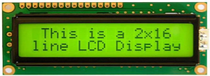
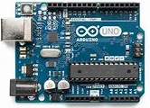
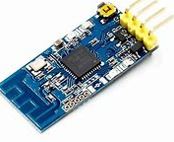
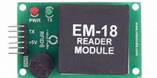

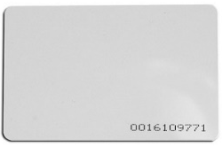
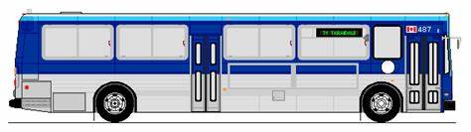

DEMONSTRATION OF PROJECT
BUS STOP

Slide 13
STATUS OF COMPONENTS PURCHASED
SI.NO | COMPONENTS | PURCHASED | NOT PURCHASED
1. | Arduino UNO | ✓
2. | RFID Reader and tags | ✓
3. | Switches | ✓
4. | 16X2 LCD | ✓
5. | I2C module | ✓
6. | Zigbee module | ✓
7. | IR sensors | ✓
8. | L293D IC | ✓
9. | DC motor | ✓

Slide 14
PROJECT EXECUTION PLAN
WEEK 1 | Discussion and purchasing of components.
WEEK 2 | To develop the code for IR sensors, LCD, RFID.
WEEK 3 | Online simulation of codes
WEEK 4 | Learn the working of Arduino UNO and develop code for DC motor.
WEEK 5 | Testing Components and Online Simulate the Project.
WEEK 6 | Set up the bus stop module and bus module.
WEEK 7 | To develop code and test for data transmission of Zigbee.
WEEK 8 | Verifying the functionality of RFID.
WEEK 9 | Fixing all the components together.
WEEK 10 | Interfacing all the components with Arduino UNO.
WEEK 11 | Testing of the project and debugging errors.
WEEK 12 | Publishing paper and updating report

Slide 15
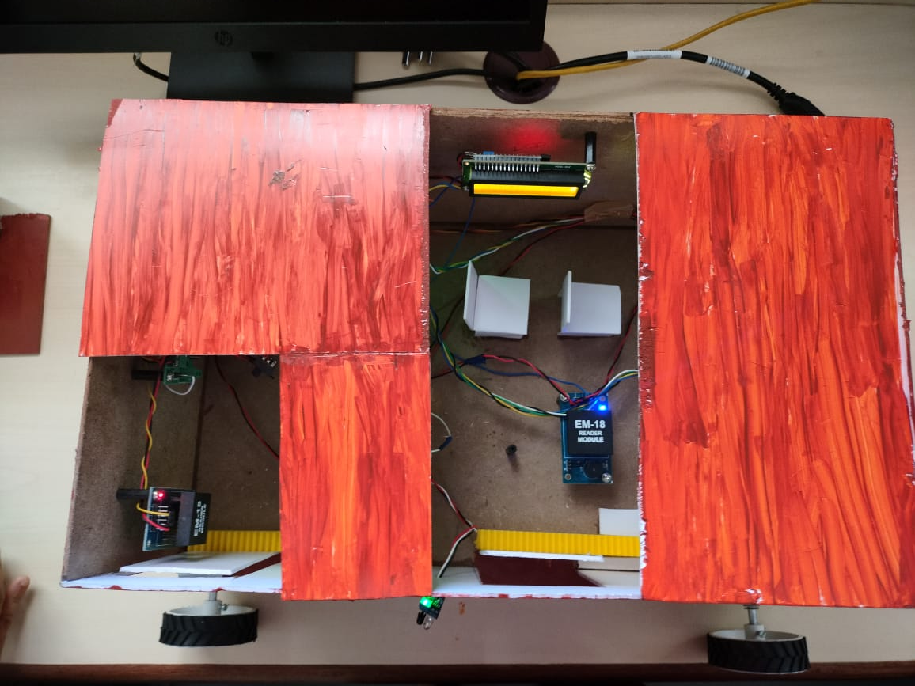
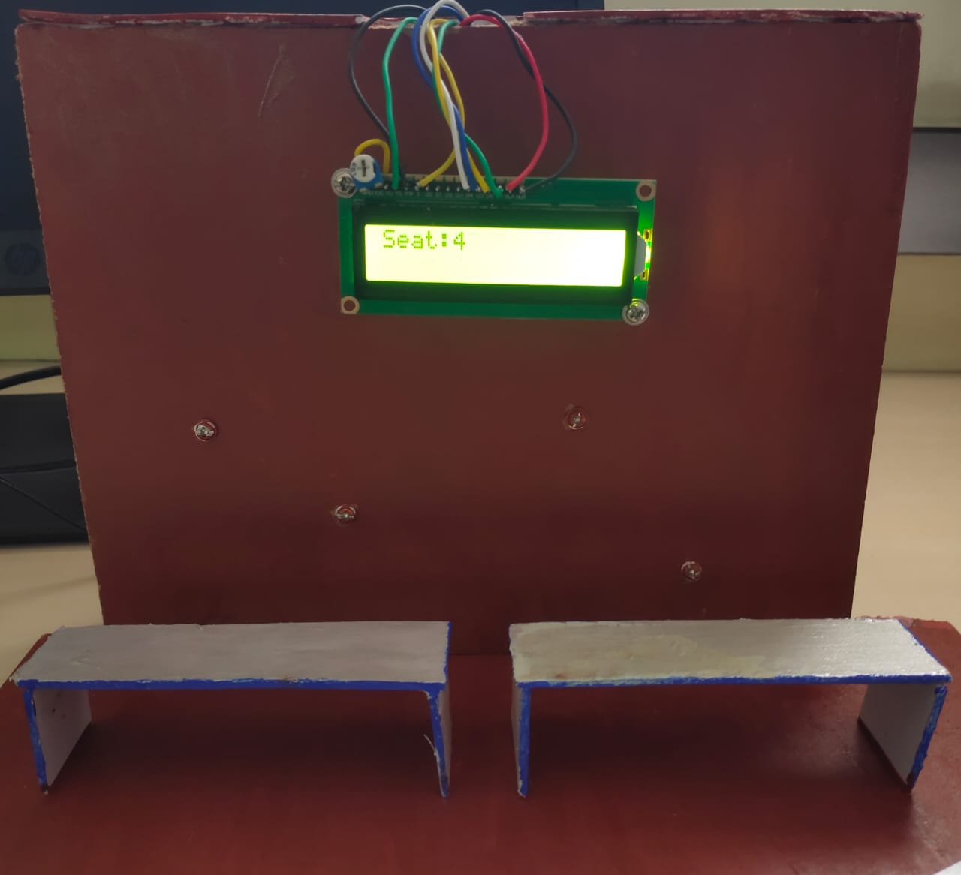
PROJECT ENVIRONMENT SETUP
Fig : Bus Module
Fig : Bus Stop Module

Slide 16
COMPARISON OF PROJECT WORK
Instead of QR Code which has limitations in range or Biometrics which causes privacy concerns, the RFID technology is very much effective and efficient.
Keeps the count of occupancy and same is updated in bus stops, which make our project more convenient for the passengers.
Using Zigbee to communicate between bus and bus stops made very easy as it doesn’t require any Wi-Fi or internet hence there is no problem of connectivity.

Slide 17
TOOLS LEARNT
Arduino IDE is a free software for programming Arduino boards.
It has a built-in text editor and allows us to upload them to the board to control doors, sensors, etc.
It acts as a translator turning instructions into a language the Arduino board understands.

Slide 18
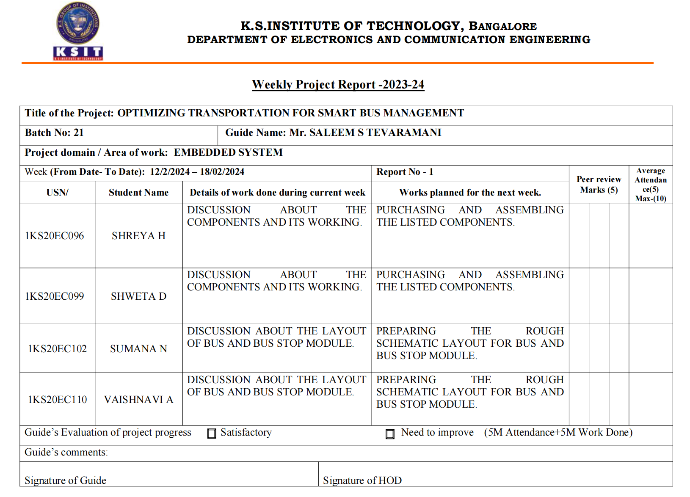
WEEKLY REPORT-WEEK 1

Slide 19
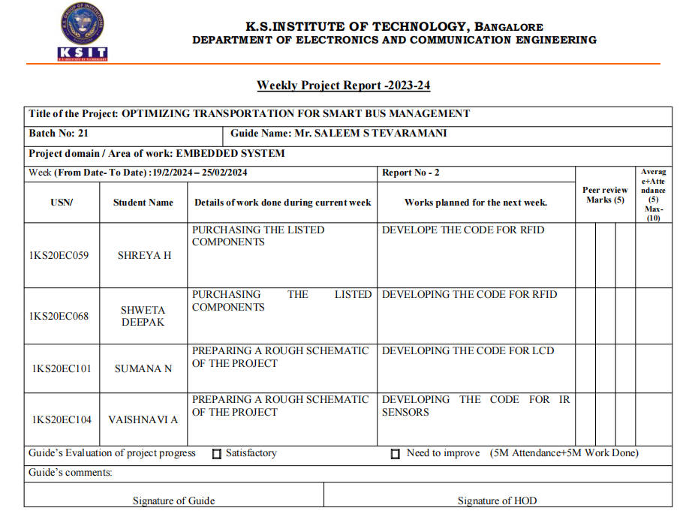
WEEKLY REPORT-WEEK 2

Slide 20
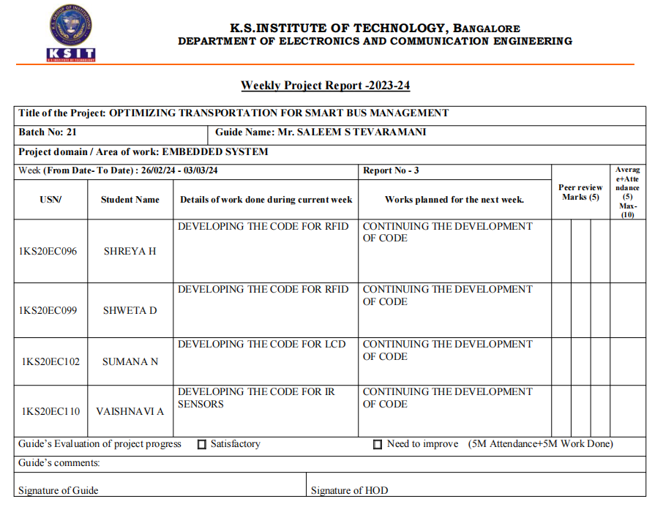
WEEKLY REPORT-WEEK 3

Slide 21
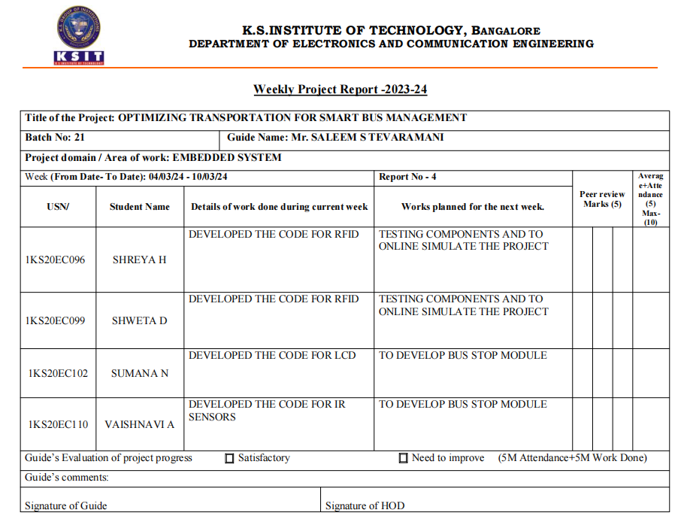
WEEKLY REPORT-WEEK 4

Slide 22
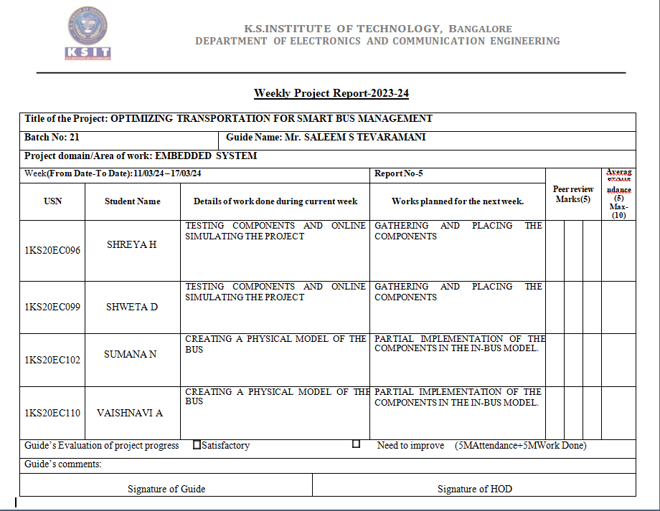
WEEKLY REPORT-WEEK 5

Slide 23
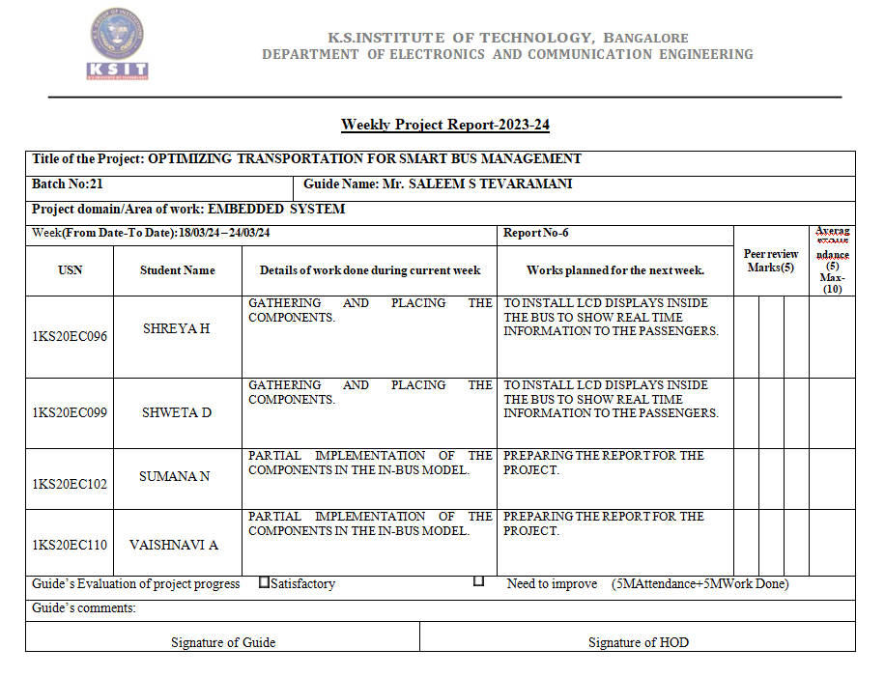
WEEKLY REPORT-WEEK 6

Slide 24
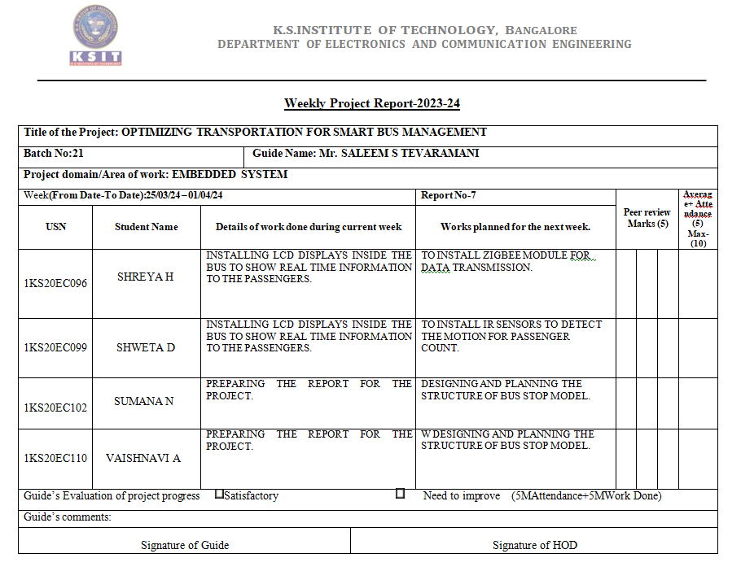
WEEKLY REPORT-WEEK 7

Slide 25
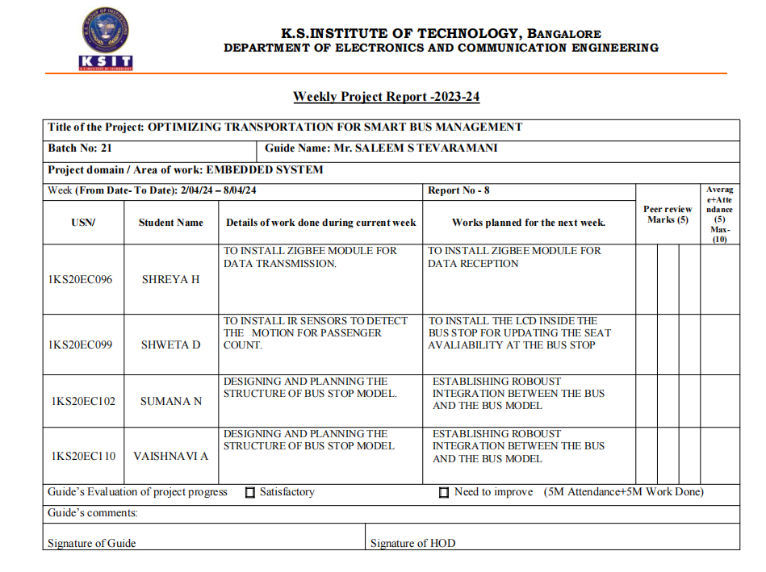
WEEKLY REPORT-WEEK 8

Slide 26
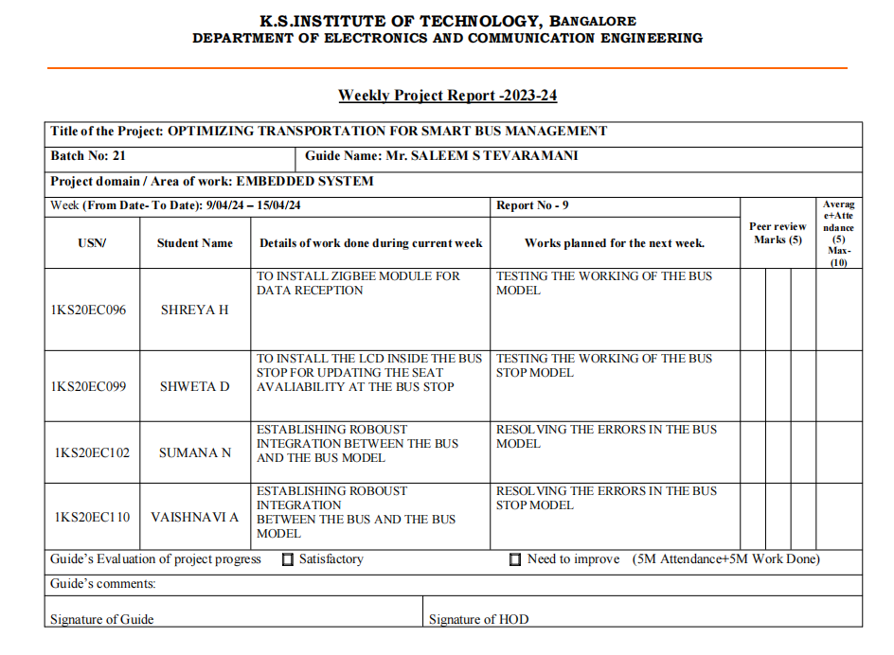
WEEKLY REPORT-WEEK 9

Slide 27
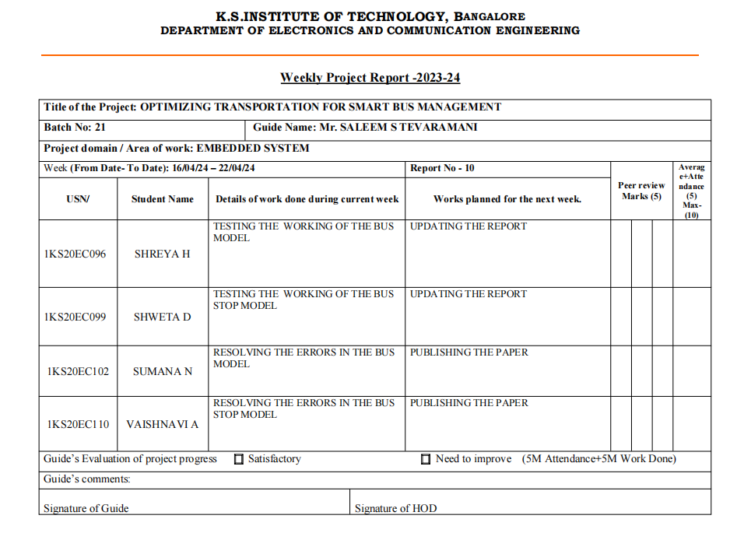
WEEKLY REPORT-WEEK 10

Slide 28
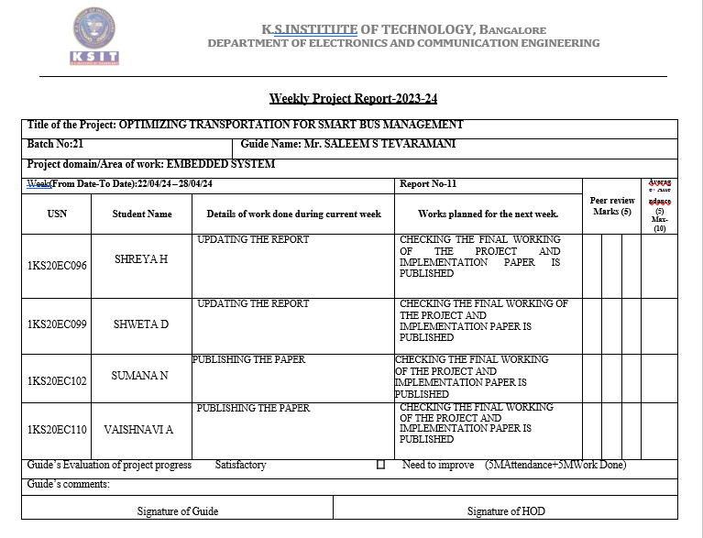
WEEKLY REPORT-WEEK 11

Slide 29
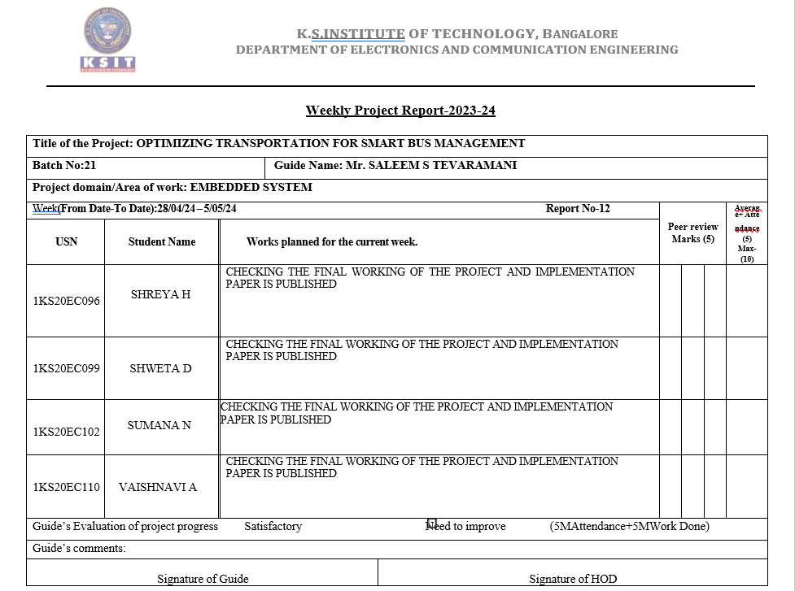
WEEKLY REPORT-WEEK 12

Slide 30
APPLICATIONS
Urban Public Transportation
Corporate Shuttles
Travel Agencies
Senior Citizen Transportation

Slide 31
CONCLUSION
Integration of bus and bus stop modules is a significant advancement in public transportation systems.
RFID technology, Arduino control units, LCD displays, and Zigbee communication modules streamline passenger management and enhance communication between the bus and the stop.
Predictive modeling can anticipate peak times, adjust services, and reduce congestion.
Advanced analytics using RFID scans, seat counts, and passenger boarding patterns can optimize bus routes, schedules, and capacity management.

Slide 32
REFERENCES
Mohini S. Shirsath ,Pooja M. Chinchole,Vaishnavi R. Mahajan, Varsha G. Mogal “Smart Bus Ticketing System using QR-Code” International Research Journal of Engineering and Technology (IRJET),Volume: 05 Issue: 03, Nov-2019
Gaurav Chheda, Jitesh Deshpande, Manal Chhaya, Niket Gajra, Saylee Gharge, “Bus Monitoring using Biometric Systems", International Journal of Soft Computing and Engineering (IJSCE) ISSN: 2231-2307, Volume-1, Issue- 6, January 2020.
Priti Shende, Pratik Bhosale, Shahnawaz Khan, Prashant Patil. “Smart Bus Management System using IOT” International Research Journal of Engineering and Technology (IRJET), Volume: 03 Issue: 02, Feb-2021.
Anandkumar A, Dinakaran K, Mani T. “Smart bus for COVID-19”. Department of Electronics and Communication Engineering, Jai Shriram Engineering College, Dec-2021
Adarsh Holikatti ,S. Mohan Kumar. “Wi-Fi based Bus Tracking System” International Journal of Advanced Networking & Applications (IJANA), ISSN: 0975-0282,Volume-2, Issue-5, Mar-2022
Ben Ammar Hatem Hamam Habib ,” Bus Management System Using RFID In WSN”,European and Mediterranean Conference on Information Systems 2010(EMCIS2010) April 12-13 2009, Abu Dhabi, UAE
Ameer H. Morad,” GPS Talking For Blind People”, Journel of emerging technologies in web intelligence, Vol. 2, No. 3, augest2010.
8. Md. Foisal Mahedi Hasan, Golam Tangim, Md. Kafiul Islam,Md. Rezwanul Haque Khandokar,Arif Ul Alam,” RFID-based Ticketing for Public Transport System: Perspective MegacityDhaka”.
9. Dhruba Ningombam, Chitra, Nitashi Kalita, Vinita Pat Pingua,” An Intelligent Voice Enabled Distance to Empty and Navigation System”,International Journal of Soft Computing and Engineering
(IJSCE) ISSN: 2231-2307, Volume-2, Issue-3, July 2012.

Slide 33
10. Qing-Jie Kong, Yikai Chen, and Yuncai Liu,(2009) "A fusion- based system for road-network traffic state surveillance: a case study of shanghai," IEEE Intelligent Transportation Systems
Magazine, vol. 1, no. 1, pp. 37-42.
11. Sheng, Q.Z., Li, X. and Zeadally, S. (2008) “Enabling Next-eneration RFID Applications: Solutions and Challenges”, IEEE Computer, Vol 41 No 9, pp 21-28.
12. Ollivier M., (1995) “RFID- a new solution technology for security problems”, European Convention on Security and Detection, 408, pp. 234-238.
13. Bo Yan, Danyu Lee; , "Design of Sight Spot Ticket Management System Based on RFID", pp. 496 - 499, 2009 International Conference on Networks Security, Wireless Communications and Trusted Computing.
14. Venugopal Prasanth, Hari Prasad R., K.P. Soman, "Ticketing Solutions for Indian Railways Using RFID Technology," act,pp.217-219, 2009 International Conference on Advances in Computing, Control, and Telecommunication Technologies, 2009.

Slide 34
THANK YOU!

